Slide 1
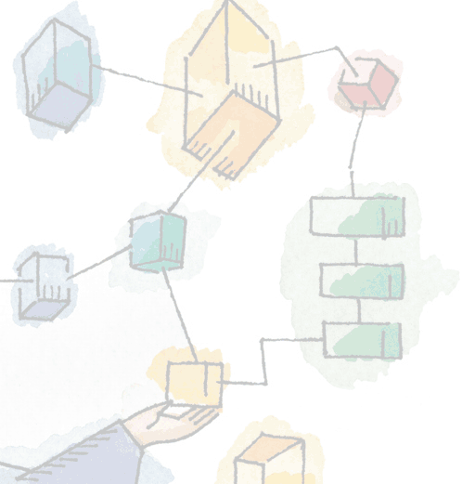
Chapter 17 Networking
Operating Systems: Internals and Design Principles, 6/E William Stallings
Notes:
These slides are intended to help a teacher develop a presentation. This PowerPoint covers the entire chapter and includes too many slides for a single delivery. Professors are encouraged to adapt this presentation in ways which are best suited for their students and environment.

Slide 2
Roadmap
The Need for a Protocol Architecture
The TCP/IP Protocol Architecture
Sockets
Linux Networking

Slide 3
Need for a Protocol Architecture
The procedures involved in exchanging data between devices can be complex
A file transfer involves
Data path
Either direct communication or provide destination information to the network
Sender must check receiver is ready and can store the data
May require file format translation
Notes:
When computers, terminals, and/or other data processing devices exchange data, the procedures involved can be quite complex.
Consider, for example, the transfer of a file between two computers.
There must be a data path between the two computers, either directly or via a communication network.
But more is needed. Typical tasks to be performed include the following:
The source system must either activate the direct data communication path or inform the communication network of the identity of the desired destination system.
The source system must ascertain that the destination system is prepared to receive data.
The file transfer application on the source system must ascertain that the file management program on the destination system is prepared to accept and store the file for this particular user.
If the file formats or data representations used on the two systems are incompatible, one or the other system must perform a format translation function.

Slide 4
Protocol
For two entities to communicate they must use the same “protocol”
Key elements of a protocol are:
Syntax: Includes such things as data format and signal levels
Semantics: Includes control information for coordination and error handling
Timing: Includes speed matching and sequencing
Notes:
A protocol is used for communication between entities in different systems.
The terms entity and system are used in a very general sense.
For two entities to communicate successfully, they must “speak the same language.”
There must be an agreement over
What is communicated,
how it iscommunicated, and
when it is communicated
The conventions are referred to as a protocol, which may be defined as a set of rules governing the exchange of data between two entities.
The key elements of a protocol are as follows:
• Syntax: Includes such things as data format and signal levels
• Semantics: Includes control information for coordination and error handling
• Timing: Includes speed matching and sequencing

Slide 5
Protocol Architecture
The computer systems need to cooperate closely to communicate.
Rather than implementing everything as a single module tasks are broken into subtasks.
Each subtask implemented separately.
Notes:
It is clear that there must be a high degree of cooperation between the two computer systems.
Instead of implementing the logic for this as a single module, the task is broken up into subtasks, each of which is implemented separately

Slide 6
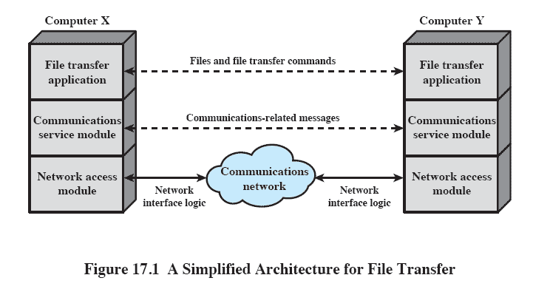
File Transfer
Notes:
This figure suggests the way in which a file transfer facility could be implemented.
Three modules are used.
The two modules on the two systems exchange files and commands.
However, rather than requiring the file transfer module to deal with the details of actually transferring data and commands, the file transfer modules each rely on a communications service module.
This module is responsible for making sure that the file transfer commands and data are reliably exchanged between systems.
The nature of the exchange between the two communications service modules is independent of the nature of the network that interconnects them.
Therefore, rather than building details of the network interface into the communications service module, it makes sense to have a third module, a network access module, that performs task 1 by interacting with the network.

Slide 7
Roadmap
The Need for a Protocol Architecture
The TCP/IP Protocol Architecture
Sockets
Linux Networking

Slide 8
TCP/IP Protocol Architecture
Five relatively independent layers
Physical
Network access
Internet
Host-to-host, or transport
Application

Slide 9
Physical Layer
Specifying
the characteristics of the transmission medium
Nature of the signals
Data rate
Notes:
The physical layer covers the physical interface between a data transmission device (e.g., workstation, computer) and a transmission medium or network.
This layer is concerned with specifying the characteristics of the transmission medium, the nature of the signals, the data rate, and related matters.

Slide 10
Network Access Layer
Concerned with the exchange of data between an end system and the network
Different standards
Circuit switching
Packet switching (frame relay)
LANs (Ethernet)
Access to, and routing through, a network
Internet Protocol (IP)
Notes:
The network access layer is concerned with the exchange of data between an end system (server, workstation, etc.) and the network to which it is attached.
The sending computer must provide the network with the address of the destination computer, so that the network may route the data to the appropriate destination.
The sending computer may wish to invoke certain services, such as priority, that might be provided by the network.
The specific software used at this layer depends on the type of network to be used;
different standards have been developed for circuit switching, packet switching (e.g., frame relay), LANs (e.g., Ethernet), and others.
Thus it makes sense to separate those functions having to do with network access into a separate layer.
By doing this, the remainder of the communications software, above the network access layer, need not be concerned about the specifics of the network to be used.
The same higher-layer software should function properly regardless of the particular network to which the computer is attached.
The network access layer is concerned with access to and routing data across a network for two end systems attached to the same network.
The Internet Protocol (IP) is used at this layer to provide the routing function across multiple networks.
This protocol is implemented not only in the end systems but also in routers.
A router is a processor that connects two networks and whose primary function is to relay data from one network to the other on a route from the source to the destination end system.

Slide 11
Transport Layer
Ensures all data arrives at the destination and in the order sent
TCP and UDP used here
Notes:
Regardless of the nature of the applications that are exchanging data, there is usually a requirement that data be exchanged reliably.
That is, we would like to be assured that all the data arrive at the destination application and that the data arrive in the same order in which they were sent.
As we shall see, the mechanisms for providing reliability are essentially independent of the nature of the applications.
Thus, it makes sense to collect those mechanisms in a common layer shared by all applications; this is referred to as the host-to-host layer, or transport layer.
The Transmission Control Protocol (TCP) is the most commonly used protocol to provide this functionality.

Slide 12
Application Layer
Supports various user application
For each different type of application a separate module is needed that is peculiar to that application.
Example: file transfer
Notes:
Finally, the application layer contains the logic needed to support the various user applications.
For each different type of application, such as file transfer, a separate module is needed that is peculiar to that application.

Slide 13
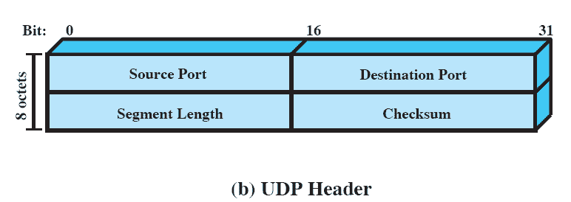
UDP Header
Connectionless transport layer protocol
Enables a process to send messages to other processes with a minimum of protocol mechanism.
Notes:
The User Datagram Protocol (UDP).
UDP does not guarantee delivery, preservation of sequence, or protection against duplication.
UDP enables a process to send messages to other processes with a minimum of protocol mechanism.
Because it is connectionless, UDP has very little to do.
Essentially, it adds a port addressing capability to IP.

Slide 14
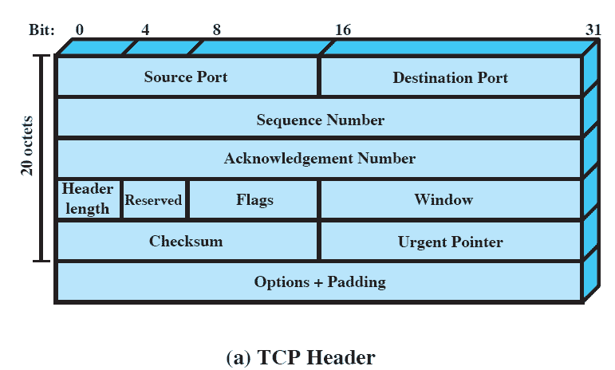
TCP Header
Connection oriented
Many of the extra fields in the TCP header are used to track connections
Notes:
For most applications running as part of the TCP/IP protocol architecture, the transport layer protocol is TCP.
TCP provides a reliable connection for the transfer of data between applications.

Slide 15
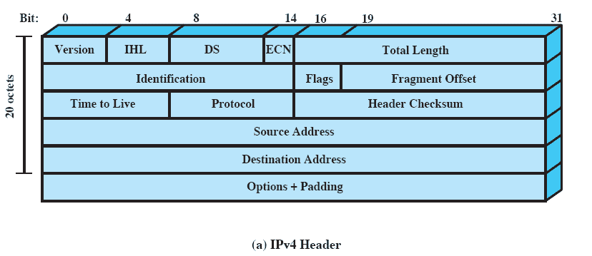
IP Datagram
IP appends a header of control information
Example: destination host address
Notes:
The header, together with the segment from the transport layer form an IP-level block referred to as an IP datagram or an IP packet.
The header includes 32-bit source and destination addresses.
The Header Checksum field is used to detect errors in the header to avoid misdelivery.
The Protocol field indicates whether TCP,UDP, or some other higher-layer protocol is using IP.
The ID, Flags, and Fragment Offset fields are used in the fragmentation and reassembly process, in which a single IP datagram is divided into multiple IP datagrams on transmission and then reassembled at the destination

Slide 16
IPv6
Provides enhancements over existing IP
Designed to accommodate higher speeds of a mix of data streams, graphic and video
Provides more addresses
Includes 128-bits for addresses
IP uses 32-bit address
Notes:
With the explosive growth of the Internet and of private networks attached to the Internet, this address length became insufficient to accommodate all systems needing addresses.

Slide 17
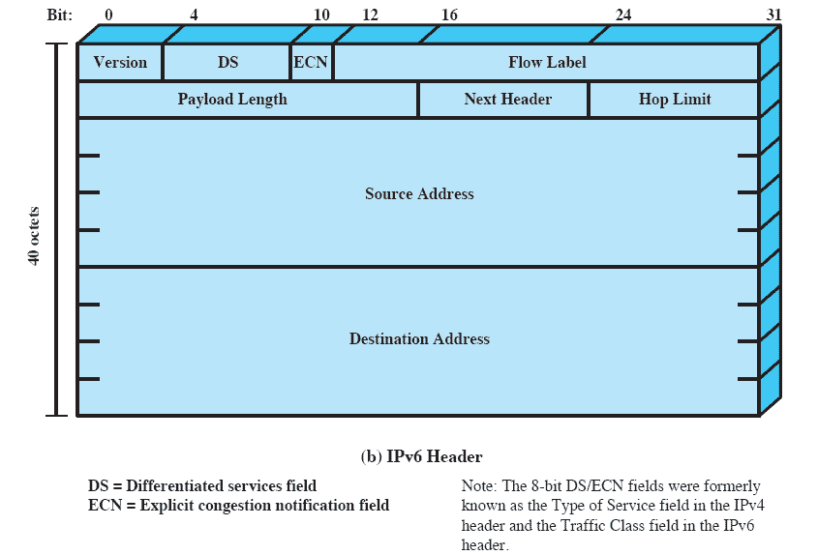
IPv6 Header
Notes:
As this figure shows, IPv6 includes 128-bit source and destination address fields.

Slide 18
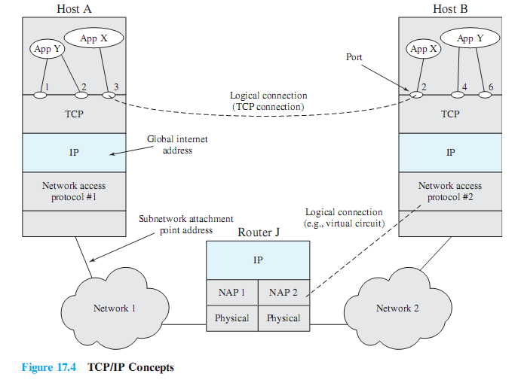
TCP/IP Concepts
Notes:
This figure indicates how these protocols are configured for communications.
Some sort of network access protocol, such as the Ethernet logic, is used to connect a computer to a network.
This protocol enables the host to send data across the network to another host or, in the case of a host on another network, to a router.
IP is implemented in all end systems and routers.
It acts as a relay to move a block of data from one host, through one or more routers, to another host.
TCP is implemented only in the end systems;
it keeps track of the blocks of data being transferred to assure that all are delivered reliably to the appropriate application.

Slide 19
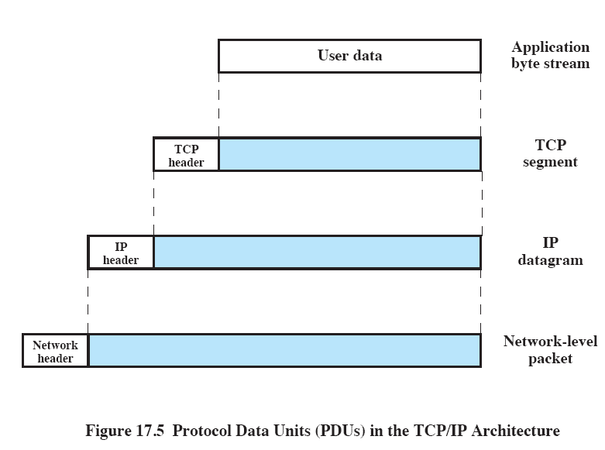
Protocol Data Units
Notes:
To control this operation, control information as well as user data must be transmitted.
Let us say that the sending process generates a block of data and passes this to TCP.
TCP may break this block into smaller pieces to make it more manageable.
To each of these pieces, TCP appends control information known as the TCP header - forming a TCP segment.
Next, TCP hands each segment over to IP, with instructions to transmit it to the destination.
These segments must be transmitted across one or more networks and relayed through one or more intermediate routers.
This operation, too, requires the use of control information.
Thus IP appends a header of control information to each segment to form an IP datagram.
Finally, each IP datagram is presented to the network access layer for transmission across the first network in its journey to the destination.
The network access layer appends its own header, creating a packet, or frame.

Slide 20
TCP/IP Applications
Many applications have been standardized to operate on top of TCP.
Simple mail transfer protocol (SMTP)
File transfer protocol (FTP)
TELNET

Slide 21
Roadmap
The Need for a Protocol Architecture
The TCP/IP Protocol Architecture
Sockets
Linux Networking

Slide 22
Sockets
An endpoint in communication
Enable communication between a client and server
The BSD transport layer interface is the de-facto standard API for most OS including:
Linux
Windows
Notes:
A socket can be considered an endpoint in a communication.
A client socket in one computer uses an address to call a server socket on another computer.
Once the appropriate sockets are engaged, the two computers can exchange data.
The Berkeley Sockets Interface is the de facto standard application programming interface (API) for developing networking applications, spanning a wide range of operating systems.

Slide 23
Types of Sockets
Stream sockets
Use TCP
Reliable data transfer
Datagram sockets
Use UDP
Delivery is not guaranteed
Raw sockets
Allow direct access to lower layer protocols
Notes:
Corresponding to the two protocols, the Sockets API recognizes two types of sockets:
stream sockets and
datagram sockets.
Stream sockets make use of TCP, which provides a connection-oriented reliable data transfer.
With stream sockets, all blocks of data sent between a pair of sockets are guaranteed for delivery and arrive in the order that they were sent.
Datagram sockets make use of UDP, which does not provide the connection-oriented features of TCP.
With datagram sockets, delivery is not guaranteed, nor is order necessarily preserved.
Raw sockets: Raw sockets allow direct access to lower layer protocols, such as IP.

Slide 24
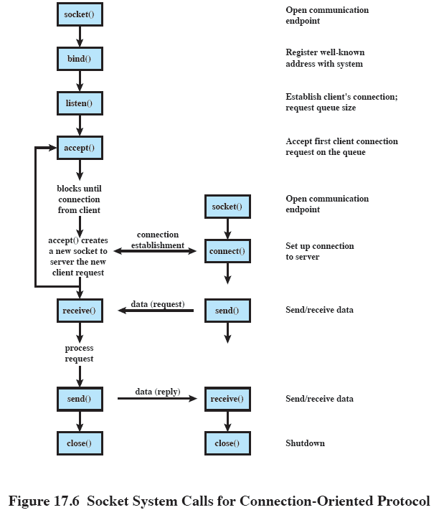
Socket System Calls
Notes:
This figure shows the typical progression of function calls for a connection oriented protocol (i.e. TCP).
These calls are discussed in following slides.

Slide 25
Socket Setup: Socket()
Three parameters
Protocol family is always PF_INET for TCP/IP
Type specifies whether stream or datagram
Protocol specifies either TCP or UDP
Returns an integer
Similar in purpose to a UNIX file descriptor
Notes:
The first step in using Sockets is to create a new socket using the socket() command.
This command includes three parameters,
the protocol family is always PF_INET, for the TCP/IP protocol suite.
Type specifies whether this is a stream or datagram socket, and
Protocol specifies either TCP or UDP.
The reason that both type and protocol need to be specified is to allow additional transport-level protocols to be included in a future implementation.
There might be more than one datagram-style transport protocol or more than one connection-oriented transport protocol.
The socket() command returns an integer result that identifies this socket;
it is similar to a UNIX file descriptor.

Slide 26
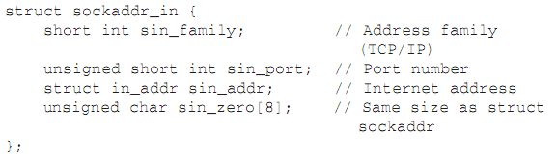
Bind()
Binds a socket to an address.
An address has the structure:
Notes:
After a socket is created, it must have an address to listen to.
The bind() function binds a socket to a socket address.
The address has the structure:
struct sockaddr_in {
short int sin_family; // Address family (TCP/IP)
unsigned short int sin_port; // Port number
struct in_addr sin_addr; // Internet address
unsigned char sin_zero[8]; // Same size as struct sockaddr
};

Slide 27
Socket Connection
One side is client
Requests connection with connect()
Other side is server
Waits for a connection request with listen()
Then accepts it with accept()
Notes:
For a stream socket, once the socket is created, a connection must be set up to a remote socket.
One side functions as a client, and requests a connection to the other side, which acts as a server.

Slide 28
Socket communication:
Once a connection is established:
Client sends data with
Stream/TCP: send()
Datagram/UDP: sendto()
Server receives data with
Stream/TCP: recv()
Datagram/UDP: recvfrom()

Slide 29
Roadmap
The Need for a Protocol Architecture
The TCP/IP Protocol Architecture
Sockets
Linux Networking

Slide 30
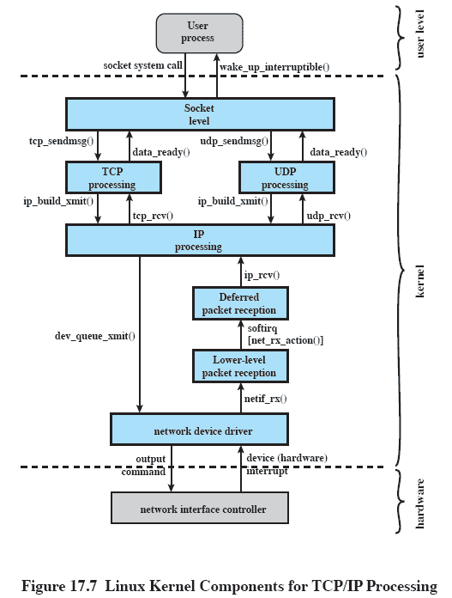
Linux Kernel Components
Notes:
Linux supports a variety of networking architectures, in particular TCP/IP by means of Berkeley Sockets.
This figure shows the overall structure of Linux support for TCP/IP.
User-level processes interact with networking devices by means of system calls to the Sockets interface.
The Sockets module in turn interacts with a software package in the kernel that handles transport-layer (TCP and UDP) and IP protocol operations.
This software package exchanges data with the device driver for the network interface card.

Slide 31
Sockets as Special Files
Linux implements sockets as special files.
In UNIX systems, a special file is one that contains no data but provides a mechanism to map physical devices to file names.
For every new socket, the Linux kernel creates a new inode in the sockfs special file system.
Notes:
Linux implements sockets as special files.
In UNIX systems, a special file is one that contains no data but provides a mechanism to map physical devices to file names.
For every new socket, the Linux kernel creates a new inode in the sockfs special file system.

